Slide 1
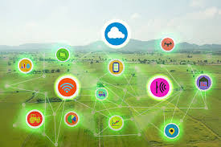
Management of Digital Ecosystem for Smart Agriculture
Tarig Khalil
CIO Sudatel Telecom Group

Slide 2
Agenda
Smart Agriculture Objectives and Challenges
Ecosystem Management Tools
What is a Smart Ecosystem
Ecosystem Main Elements
Why Smart Agriculture?
Conclusion
Smart Agriculture Applications

Slide 3
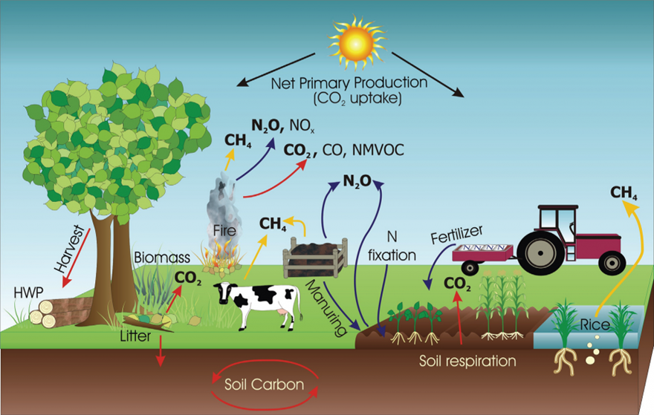
Smart Agriculture Objectives and Challenges
Objectives:
Sustainably, increasing agricultural productivity and incomes.
Adapting and building resilience to climate change.
Reducing and/or removing greenhouse gas emissions, where possible.

Slide 4
Smart Agriculture Objectives and Challenges
Challenges:
Based on this approach, farms should:
Increase efficiency, helping farmers maximize yields for every kilo fertilizer applied through knowledge sharing, balanced and crop-specific nutrition and technology.
Reduce emissions from fertilizer manufacturing.
Optimize productivity on existing farmland, reducing pressure for deforestation.
Adapt to water scarcity through product and technology development.

Slide 5
Why Smart Agriculture ?
Optimization via monitoring and control via collection of high amount of data, collected by smart agriculture sensors, e.g. weather conditions, soil quality, crop’s growth progress or cattle’s health
Better control over the internal processes and, as a result, lower production risks
Cost management and waste reduction thanks to the increased control over the production
Increased business efficiency through process automation
Achieve enhanced product quality and volumes

Slide 6
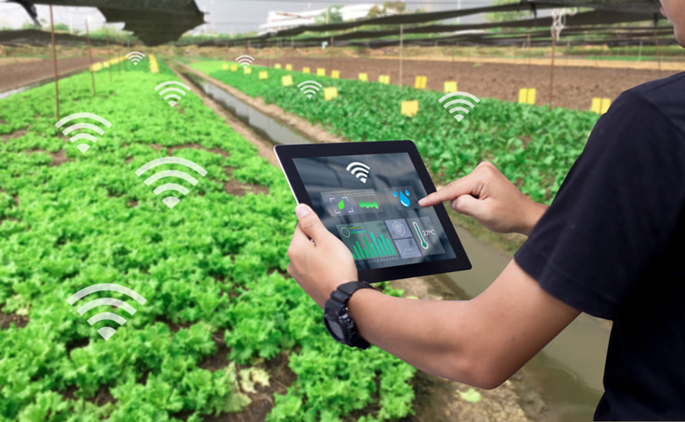
Smart Agriculture applications
IoT Use Cases in Agriculture
Monitoring of Climate Conditions
Greenhouse Automation
Crop Management
Cattle Monitoring and Management
End-to-End Farm Management Systems
Smart irrigation
Precision agriculture and field management
Measure soil moisture content
Measure nitrogen content in the soil

Slide 7
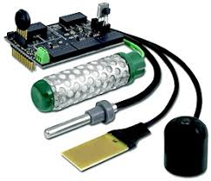
IoT Technical Landscape

Slide 8
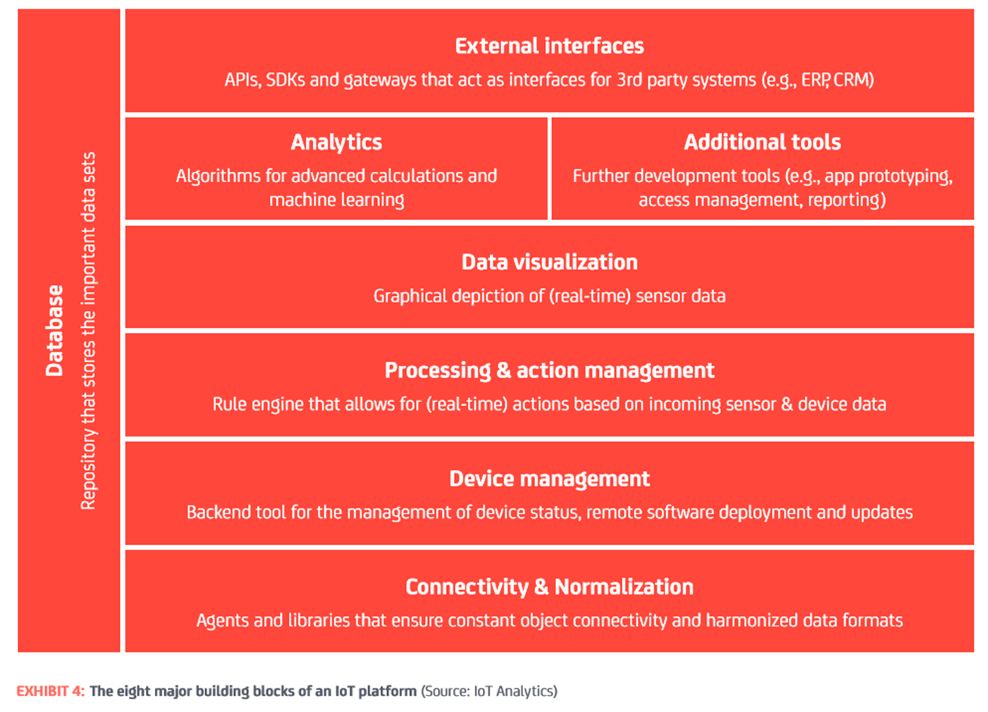
The Major building blocks for an IoT platform

Slide 9
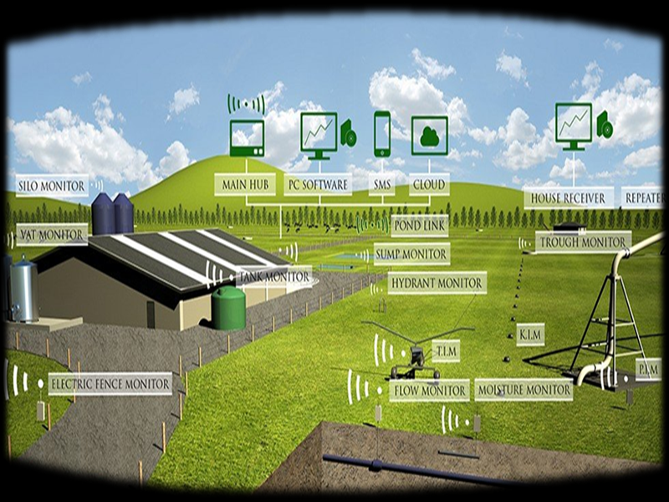
What is a Smart Ecosystem?
“A Smart ecosystem is an interdependent group of enterprises, people and/or things that share standardized digital platforms for a mutually beneficial purpose.
Digital ecosystems enable you to interact with customers, partners, adjacent industries ‒ and even your competition.”

Slide 10
Ecosystem Elements
Stakeholders:
Business owner
Public Sector
Business & Technology
Sponsor(Donor)
Environment authority
Health department
Regulatory bodies
Public central information center
Public research centers and statistic departments
Taxation authority
..
Telecom operators
Platform providers
Software solution’s providers
IoT solutions providers
Drones and robotics vendors
Smart irrigation solutions provider
Business and technical consultants
..

Slide 11
Ecosystem Elements
Things
Technical Elements:
Business Elements:
Plants
Animals
Soil
Weather
Buildings, Stores
Water
Agro-products
Sensors
Telco Network
IT Cloud Platform
BI Analytics
Drones
AI robotics
Standard APIs
Business Model
Commercial agreements & Contract
QMS
Business Processes
Scope
Integration & interaction Elements:
Technical Interfaces (standard APIs )
Contracts and agreements (SLA)
Information and data Exchange
Money transfer
Reporting

Slide 12
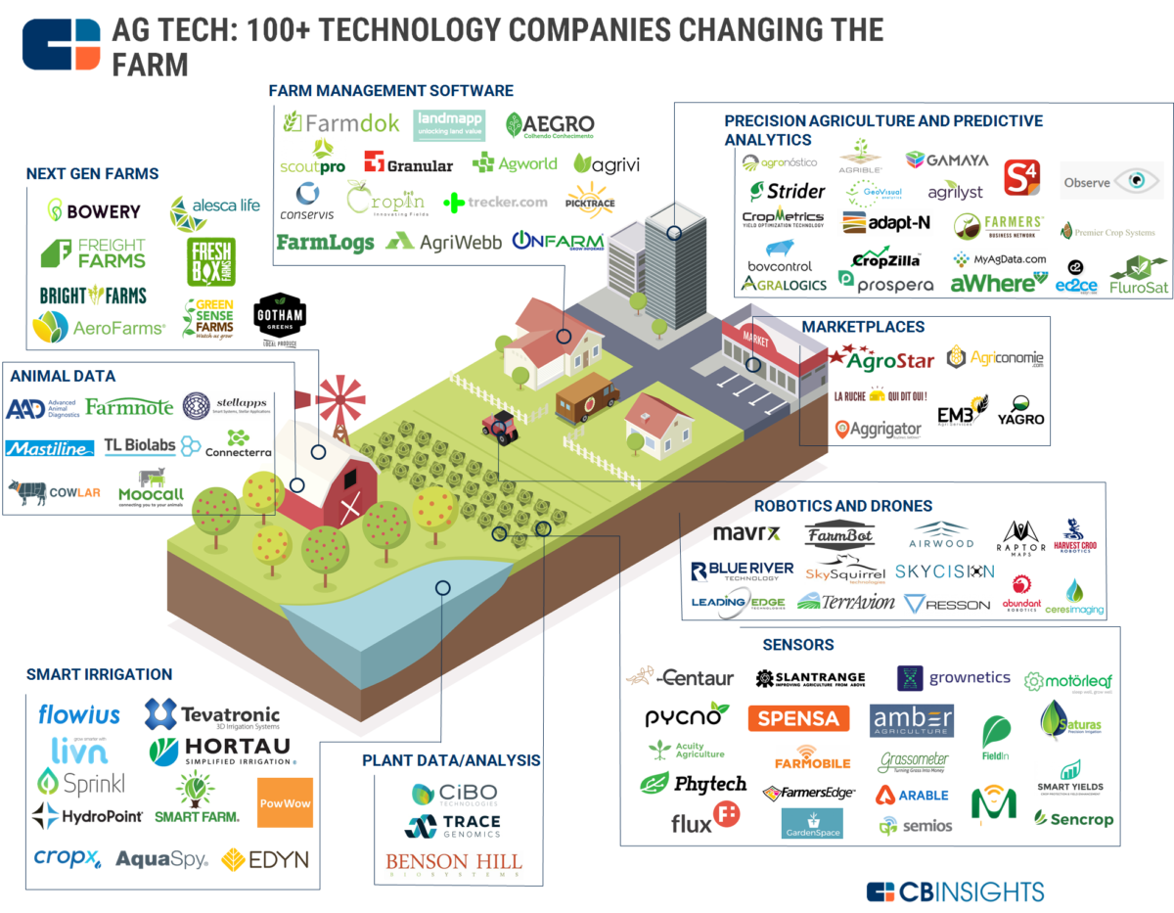
Technical and Business Products

Slide 13
https://vimeo.com/256785262
https://www.tmforum.org/curatefx/using-curatefx/
Ecosystem Management Software Tool

Slide 14
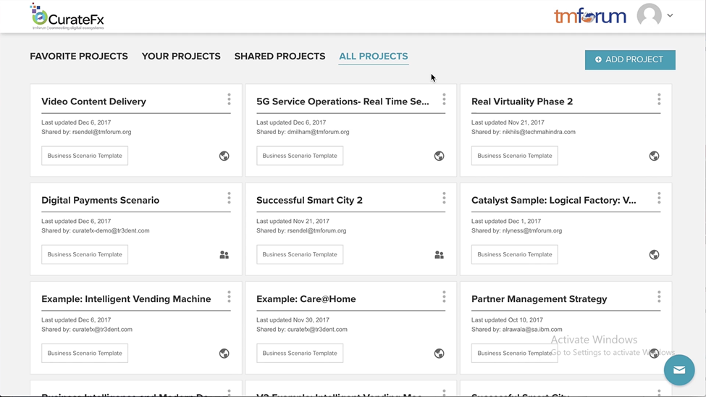
Ecosystem Management Software Tool
https://vimeo.com/256785262
https://www.tmforum.org/curatefx/using-curatefx/
Smart Agriculture
Smart Agriculture

Slide 15
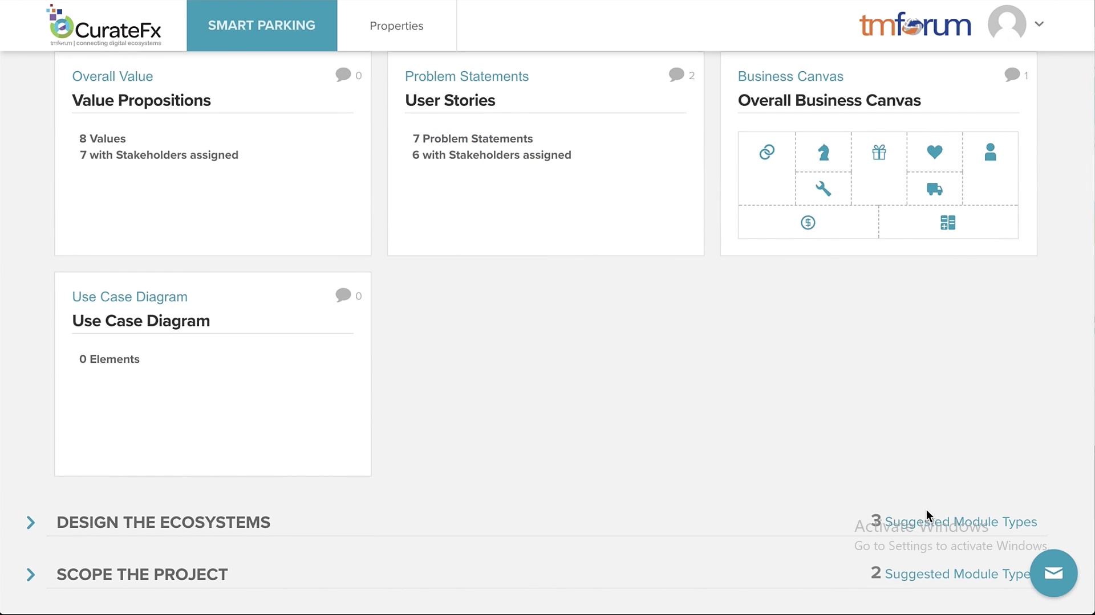
Ecosystem Management Software Tool

Slide 16
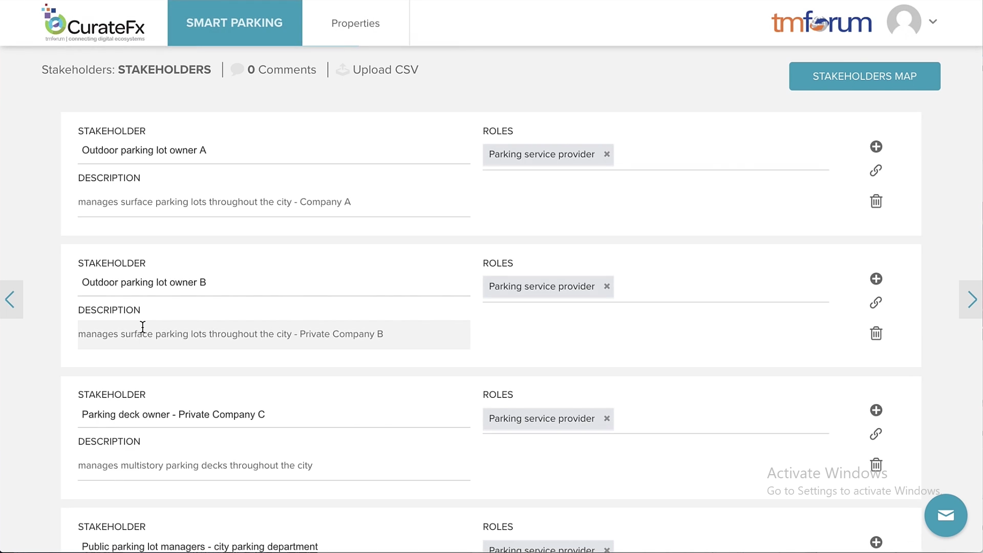
Ecosystem Management Software Tool

Slide 17
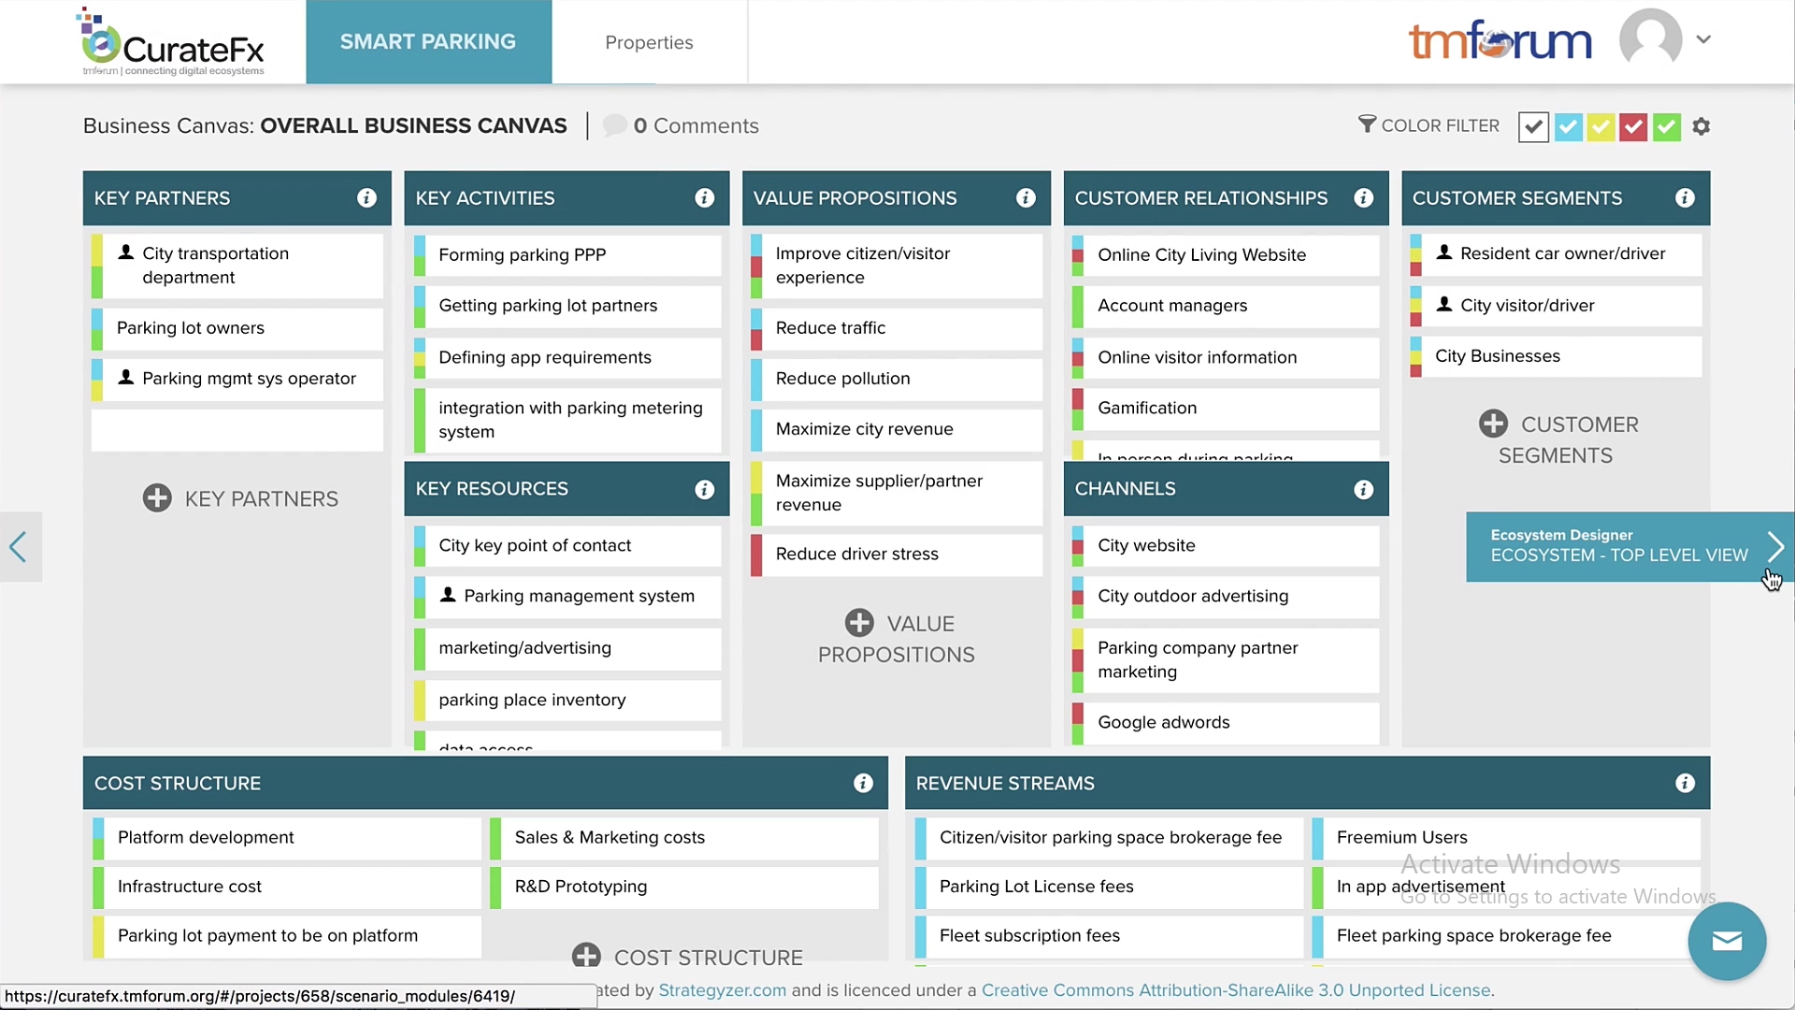
Ecosystem Management Software Tool

Slide 18
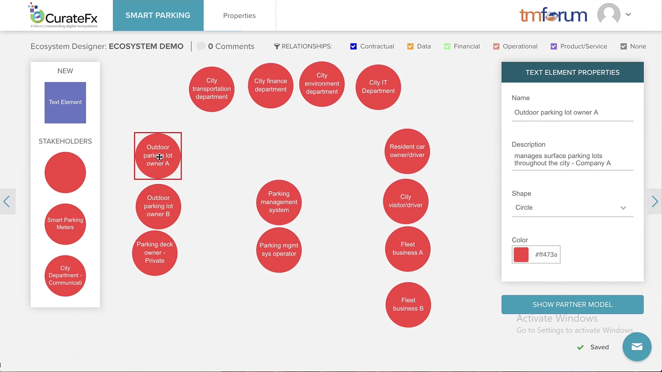
Ecosystem Management Software Tool

Slide 19
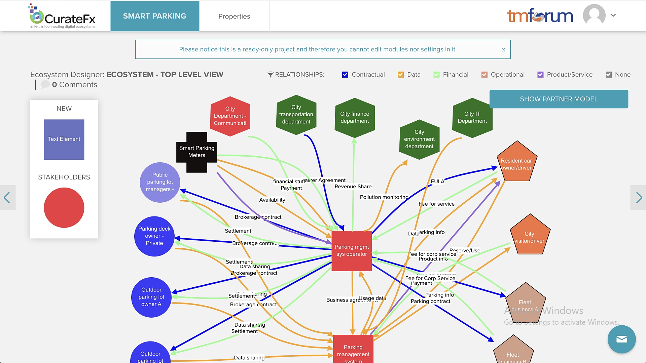
Ecosystem Management Software Tool

Slide 20
Thanks

